Slide 1
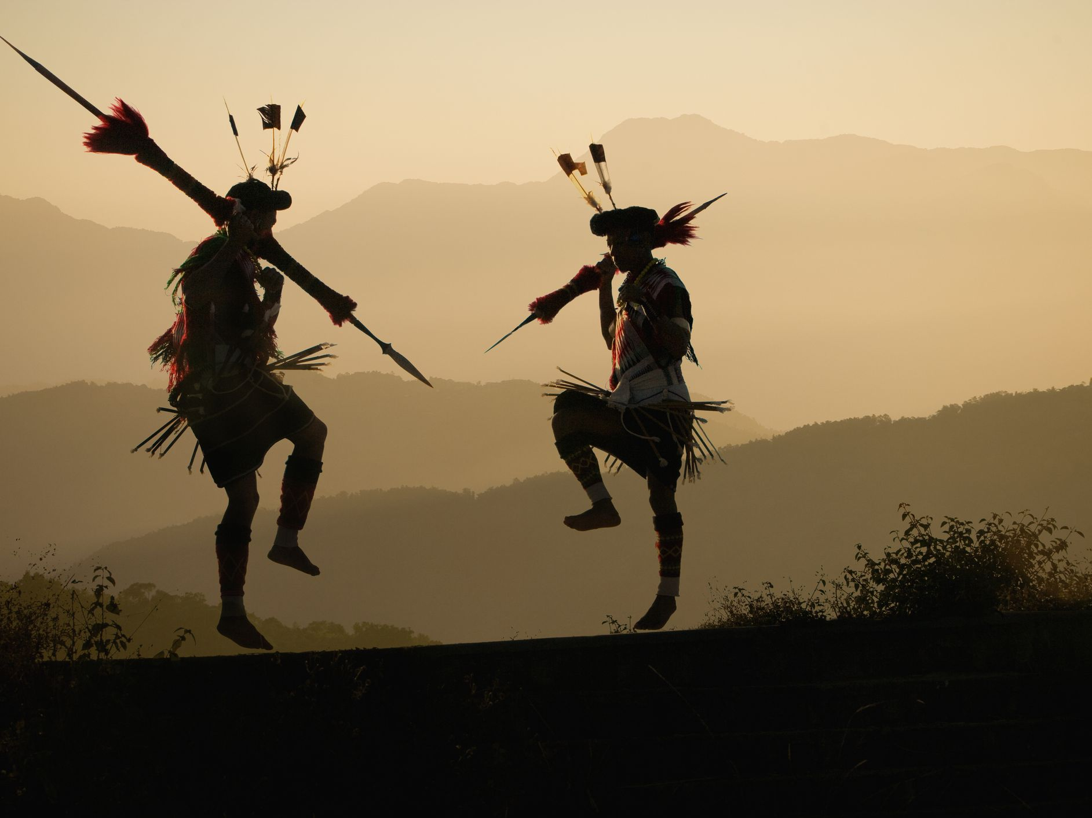
Sol. Sikap
Language – English/hindi/LoCAL DIALECT
07.46 – 8.00 am
ARUNACHAL PRADESH
ASSAM
MANIPUR
MEGHALAYA
MIZORAM
NAGALAND
SIKKIM
TRIPURA
North-East Region

Slide 2
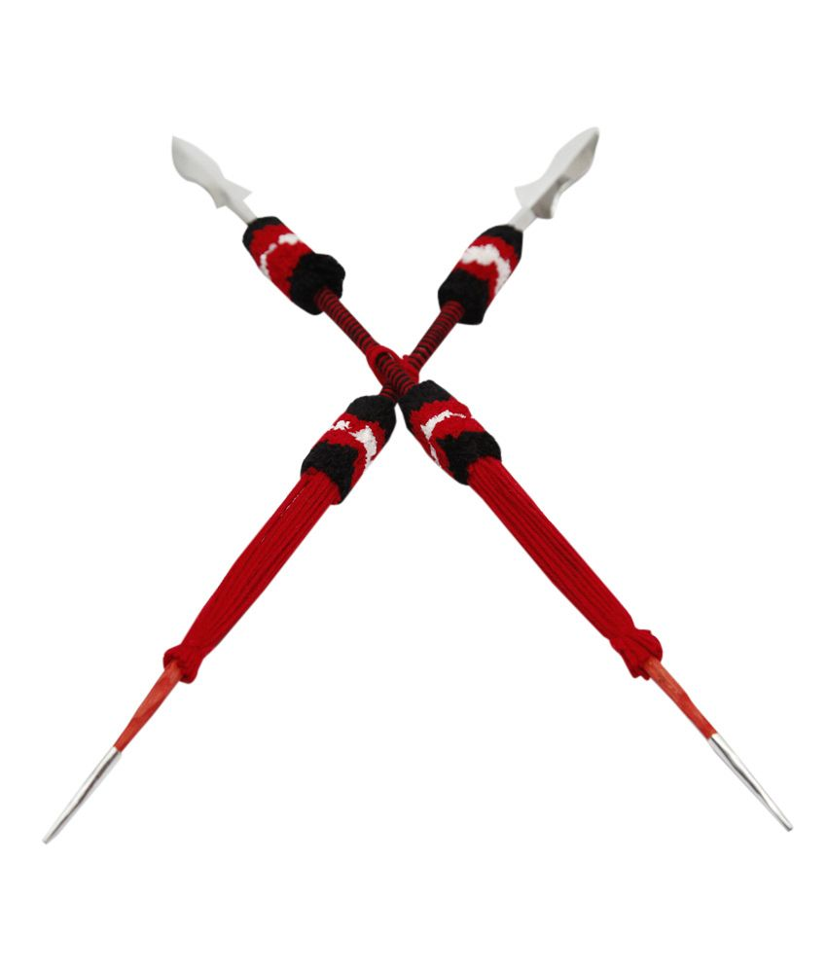
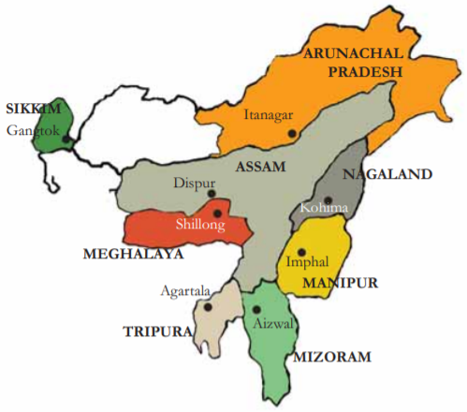
NORTH EAST INDIA
Location map

Slide 3
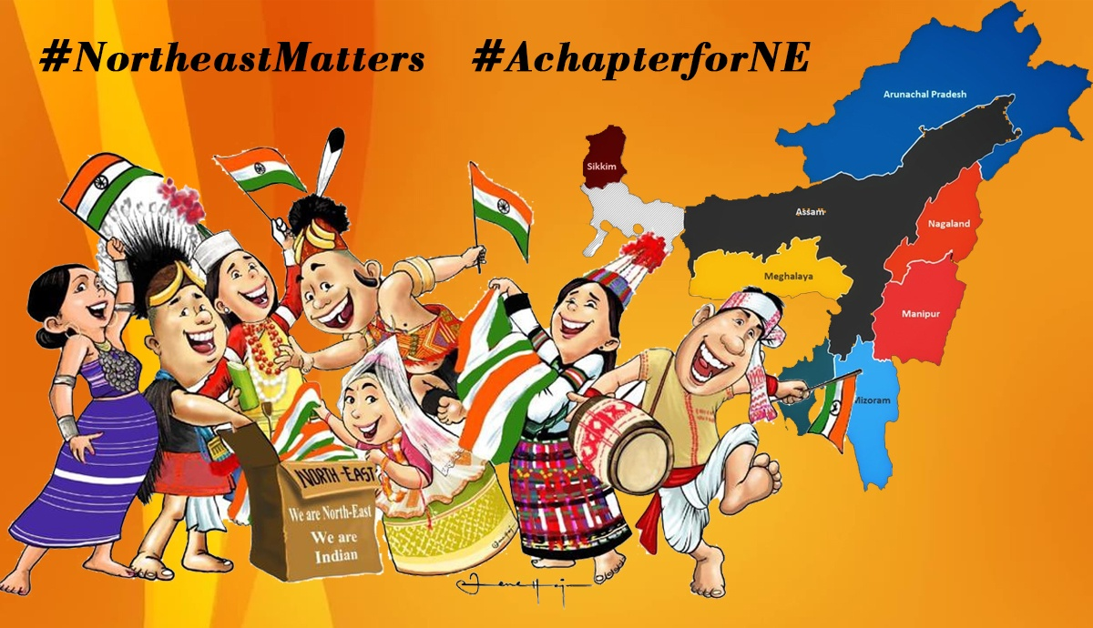
Total area : 83,743km²
Total Population
17,48,873
(As per 2021 Census of Arunachal Pradesh)

Slide 4
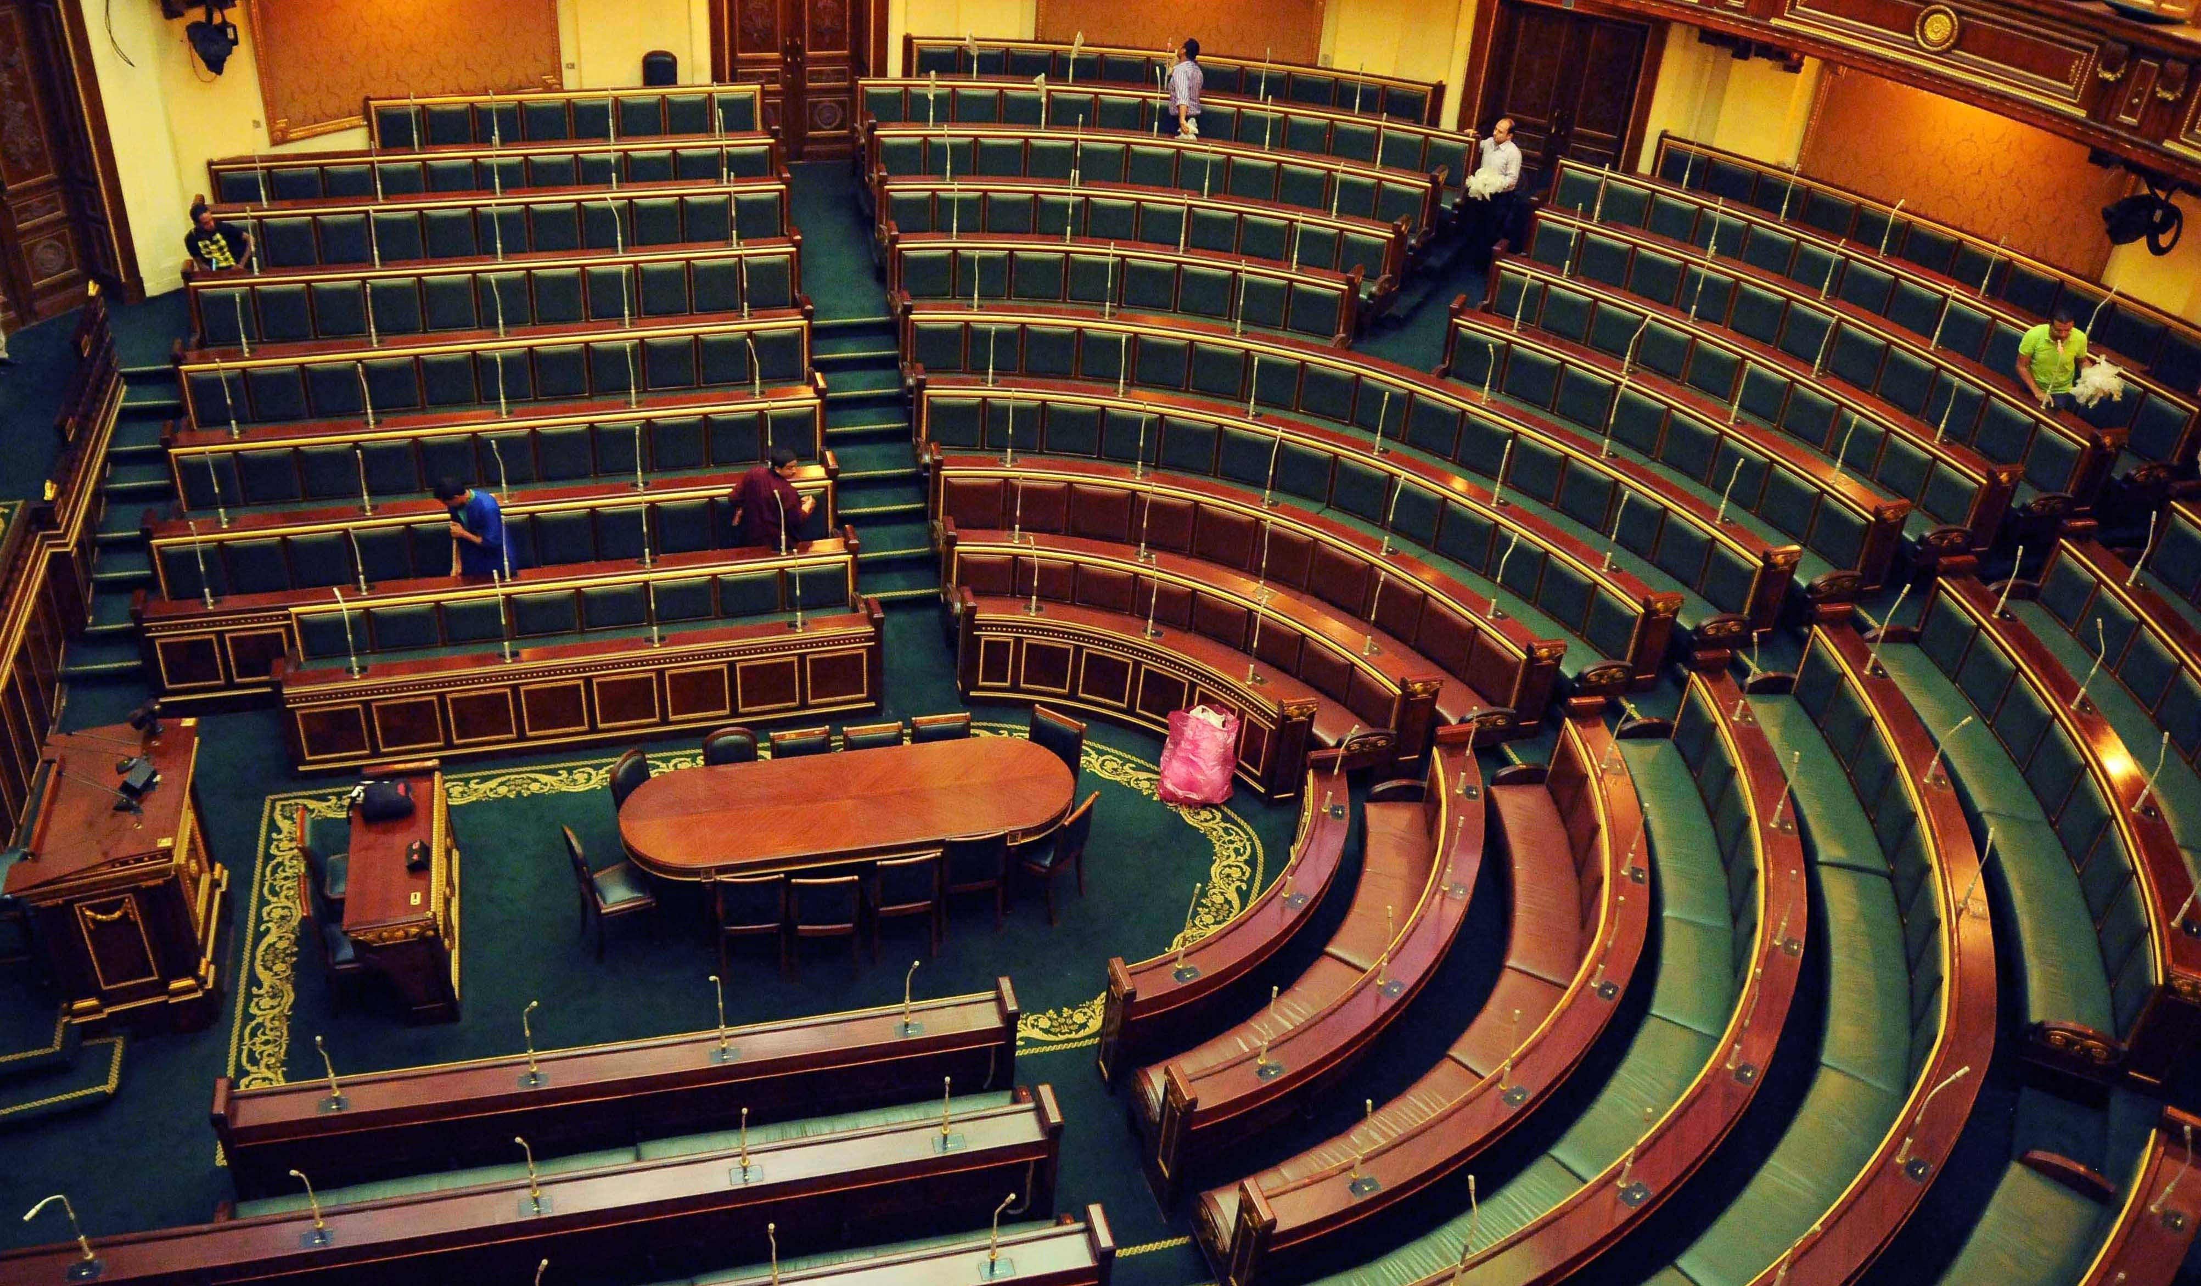
1) ARUNACHAL PRADESH : 2 SMPs
2) ASSAM : 14 SMPs
3) MANIPUR : 2 SMPs
4) MEGHALAYA : 2 SMPs
5) MIZORAM :1 SMP
6) NAGALAND : 1 SMP
7) SIKKIM : 1 SMP
8) TRIPURA : 2 SMPs
NO. OF MPs & SMPs STATE-WISE
2Chronicls 7:14
If My people who are called by My name will humble themselves, and pray and seek My face, and turn from their wicked ways, then I will hear from heaven, and will forgive their sin and heal their land.

Slide 5

PRAISE FROM THE NORTH-EAST INDIA
(THE ZION ZONE)
8 STATES

Slide 6
We thank God for introducing NE to the AoJ ministries and for inheriting
1) ARUNACHAL PRADESH
2) ASSAM
3) MANIPUR
4) MEGHALAYA
5) MIZORAM
6) NAGALAND
7) SIKKIM
8) TRIPURA
and keeping us under His triple layer protection then on!

Slide 7
STATE-WISE REPORTS
…in alphabetical order…

Slide 8
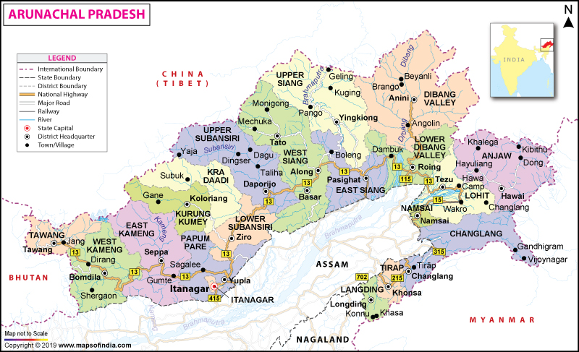
1. ARUNACHAL PRADESH is a state in Northeast India. It was formed from the erstwhile North-East Frontier Agency region, and became a state on
20 February 1987.
Northeast India by area . Arunachal Pradesh means
“Land of Dawn-lit Mountains”

Slide 10
Arunachal Pradesh
has got 60 Assembly Constituencies
Name of PC | Name of MP | Name of SMP | Inherited | DOI
1) ARUNACHAL (WEST) | Mr. Kiren Rijiju | Sol. Lokam Sikap | Yes | 06.02.2022
2) ARUNACHAL (EAST) | Mr. Tapir Gao | Sol. Dr. David Pertin | Yes | 01.02.2020
Arunachal Pradesh has got 60 Assembly Constituencies

Slide 11
S/No. | ARUNACHAL PRASEDH Name of Constituency | Speaker : Sol. Anu Name of MLA | Name of SMLA | DOI
1 | Lumla | Shri Jambey Tashi | Sol.Ama | 25. .03.2022
2 | Tawang | Shri Tsering Tashi | Sol.Yania | 25. .03.2022
3 | Miukto | Shri Pema Khandu | Sis.N.Ani P | 20.03.2022
4 | Dirang | Shri Phurpa Tsering | Sol. Tenzing | 25. .03.2022
5 | Kalatang | Shri T.N. Thongdok | Sol. Manju | 25. .03.2022
6 | Thrizno Buragoan | Shri Kumsi Sidisow | Sol.Anu | 25. .03.2022
7 | Bomdila | Shri Japu Diru | Sol. Tate | 25. .03.2022

Slide 12
S/No. | ARUNACHAL PRASEDH Name of Constituency | Speaker : Sol. Anu Name of MLA | Name of SMLA | DOI
8 | Bameng | Shri H.Manpi | Sol.Hirah Nabam | 20.03.2022
9 | Chayangtajo | Smti. Karya Bgang | Bro. Johnson Kapa Lokam | 20.03.2022
10 | Seppa East | Shri.Tapuk Taku | Sol. Jordan A L | 20.03.2022
11 | Seppa West | Mama Natung | Sol.L.Joshua | 20.03.2022
12 | Pakke Kessang | Shri B.Waghe | Bro.Anil Techi Tara | 20.03.2022
13 | Itanagar | ShriT echi Kaso | Sis. T.Melu N | 01.01.2022
14 | Doimukh | Shri Tana Hali | Sis. C.Yatup Ng. | 20.03.2022

Slide 13
S/No. | ARUNACHAL PRASEDH Name of Constituency | Speaker : Sol. Anu Name of MLA | Name of SMLA | DOI
15 | Sagalee | Nabam Tuki | Bro.Harih Nabam | 01.01.2022
16 | Yachuli | Taba Tader | Bro.Gollo Tadik | 20.03.2022
17 | Ziro-Hapoli | Tage Taki | Sis. Michi Yaniung | 20.03.2022
18 | Palin | Balo Raja | Sol.Dominica | 16.03.2022
19 | Nyapin | Bamang Felix | Sis. Rillung | 20.03.2022
20 | Tali | Jikke Tako | Sol. N.Jermin | 01.01.2022
21 | Koloriang | Lokam Tassar | Sis. N Yapa M | 20.03.2022

Slide 14
S/No. | ARUNACHAL PRASEDH Name of Constituency | Speaker : Sol. Anu Name of MLA | Name of SMLA | DOI
22 | Nacho | Shri Nakap Nalo | Bro.Benny | 25. .03.2022
23 | Taliha | Shri Nyaito Regia | Bro. Geto | 25. .03.2022
24 | Daporijo | Shri Dikto Yikar | Sis Yalung | 25. .03.2022
25 | Raga | Shri Tarin Dakpe | Sis Angku | 25. .03.2022
26 | Dumporijo | Shri Paknga Bage | Sis. Yanga Digbak | 25. .03.2022
27 | Liromoba | Shri Nyamar Karbak | Sis Tojom | 25. .03.2022
28 | Likhabali | Shri Jomde Kena | Sis Jumrik | 25. .03.2022

Slide 15
S/No. | ARUNACHAL PRASEDH Name of Constituency | Speaker : Sol. Anu Name of MLA | Name of SMLA | DOI
29 | Basar | Shri Gokar Basar | Sis. Manju | 25. .03.2022
30 | Aalo-West | Shri Tumke Bagra | Sis. L.Ete | 25. .03.2022
31 | Aalo-East | Shri Kinto Jini | Sis.Siku | 25. .03.2022
32 | Rumgong | Shri Talem Taboh | Sis Pame | 25. .03.2022
33 | Mechuka | Shri Pasang Dorjee Sona | Sis Yaru | 25. .03.2022
34 | Tuting -Yingkiong | Shri Aalo Libang | Sis Jirsum | 25. .03.2022
35 | Pangin | Shri Ojing Tasing | Bro Tagam | 25. .03.2022

Slide 16
S/No. | ARUNACHAL PRASEDH Name of Constituency | Speaker : Sol. Anu Name of MLA | Name of SMLA | DOI
36 | Nari-Koyu | Shri Kento Rina | Sis P Riba | 25. .03.2022
37 | Pasighat -West | Shri Ninong Eiring | Bro.Nyagi Regia | 25. .03.2022
38 | Pasighat-East | Shri Kaling Moyong | Sis Meninang | 25. .03.2022
39 | Mebo | Shri Lumbo Tayeng | Sis Yaluk | 25. .03.2022
40 | Mariyang-Geku | Shri Kanggong Taku | Sis Yaram | 25. .03.2022
41 | Anini | Shri Mopi Mihu | Sis Apung | 25. .03.2022
42 | Dambuk | Smti Gum Tayeng | Sis Nadam | 25. .03.2022

Slide 17
S/No. | ARUNACHAL PRASEDH Name of Constituency | Speaker : Sol. Anu Name of MLA | Name of SMLA | DOI
43 | Roing | Shri Mutchu Mithi | Sis Reena | 25.03.2022
44 | Tezu | Shri Kariko Kri | Sis Onya | 25.03.2022
45 | Hayuliang | Smti Dasanglu Pul | Sis Ancy | 25.03.2022
46 | Chowkham | Shri Chowna Mein | Sis Kolem | 25.03.2022
47 | Namsai | Shri Chau Zingnu Namchoom | Sis Assu | 25.03.2022
48 | Lekang | Smti Jummum Ete Deori | Sis Seema | 25.03.2022
49 | Bordumsa-Diyun | Shri Somlung Mossang | Sis Yanu | 27.03.2022

Slide 18
S/No. | ARUNACHAL PRASEDH Name of Constituency | Speaker : Sol. Anu Name of MLA | Name of SMLA | DOI
50 | Miao | Shri Kamlung Mosang | Dr. Mossang | 27.03.2022
51 | Nampong | Shri Laisam Simai | Sis Yakiang | 27.03.2022
52 | Changlang-South | Shri Phosum khimhun | Sis Tame Eza | 27.03.2022
53 | Changlang-North | Shri Tisam Pongte | Sis Puna Rema | 27.03.2022
54 | Namsang | Shri Wangki Lowang | Sis Yachik | 27.03.2022
55 | Khonsa -East | Shri Wanglam Sawin | Bro. Gollo Tate | 27.03.2022
56 | Khonsa-West | Smti Chakat Aboh | Sis Anga Gongo | 27.03.2022

Slide 19
S/No. | ARUNACHAL PRASEDH Name of Constituency | Speaker : Sol. Anu Name of MLA | Name of SMLA | DOI
57 | Borduria-Bogapani | Shri Wanglin Lowangdong | Sis Yallung
58 | Kanubari | Shri Gabriel Dewang Wangsu | Sis Jocelyn
59 | Longding-Pumao | Shri Tanpho Wangnaw | Sis Roshni
60 | Pongchau-Wakka | Shri Homchun Ngandam | Bro Magam

Slide 20
Needs the Lord’s attention, cleansing, people’s repentance, rectification & restoration by our Lord:
Addiction of drug, mobile,etc.
Heavy imports of food grains and basic primary products have drained away the financial resources of the state.

Slide 21
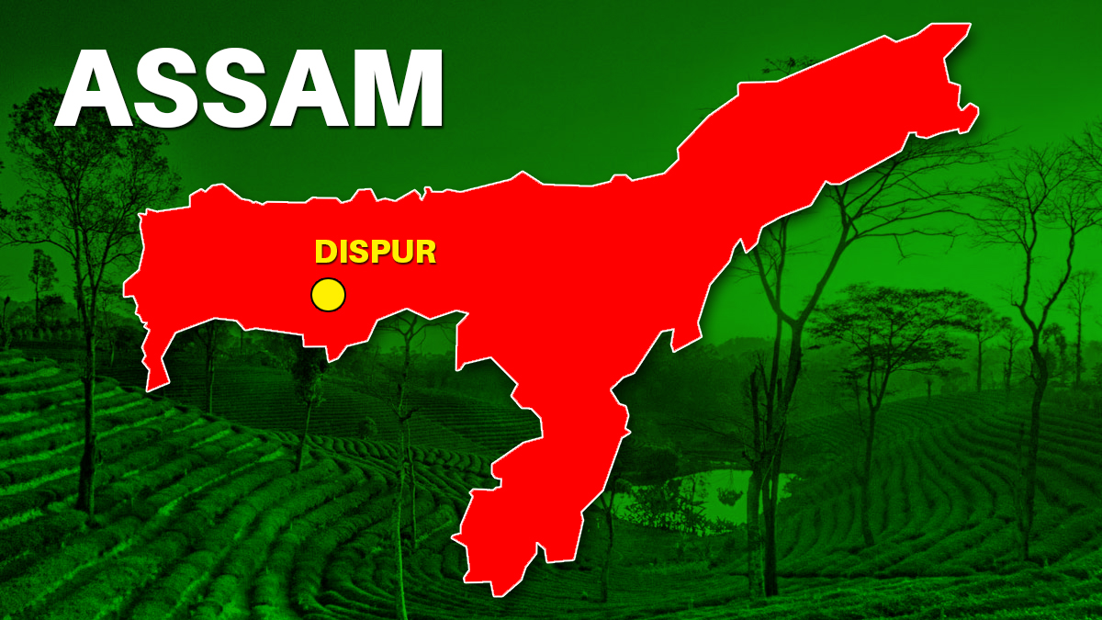
Assam is a state in northeastern India known for its wildlife, archeological sites and tea plantations. along the Brahmaputra and Barak River valleys. It is home of the one-horned rhinoceros, wild water buffalo & pygmy hog.

Slide 22
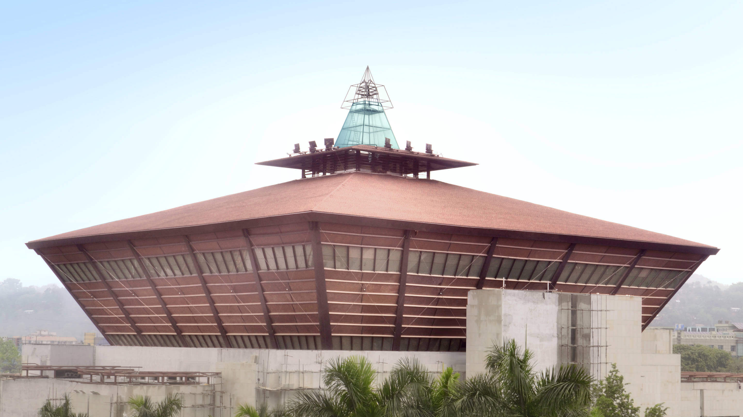
ASSAM Shadow Parli
Speaker: Sol. Rani
Total 126 Assembly Constituencies
Psalms 46:1 God is our refuge and strength, an ever-present help in trouble.

Slide 23
Gift school on goin in the state
Morning worship
FRP I from 7/3/2022 to 16/3/2022
Healing I from 23 /3/2022 to 30/3/2022

Slide 24
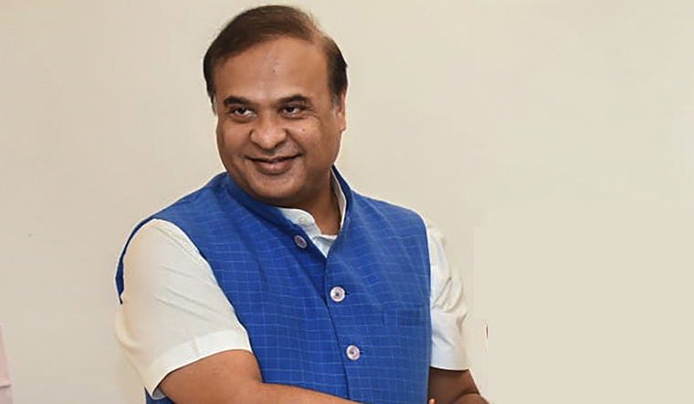
CM : Dr. Himanta Biswa Sarma
In the west, Guwahati, Assam’s largest city, features silk bazaars and the hilltop Kamakhya Temple. Umananda Temple sits on Peacock Island in the Brahmaputra river. The state capital, Dispur, is a suburb of Guwahati. The ancient pilgrimage site of Hajo and Madan Kamdev, the ruins of a temple complex, lie

Slide 25

Manipur is a state in Northeast India, with the city of Imphal as its capital. It is bounded by the Indian states of Nagaland to the north, Mizoram to the south and Assam to the west. It also borders two regions of Myanmar, Sagaing Region to the east and Chin State to the south.

Slide 26
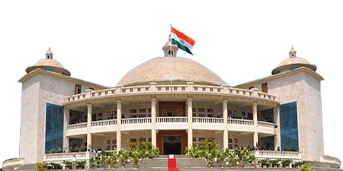
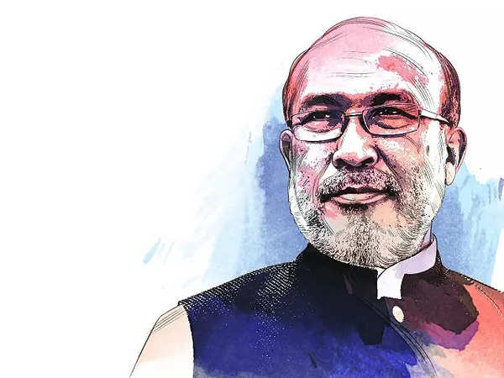
Imphal as its capital
CM : Mr. N. Biren Singh
has got 60 Assembly Constituencies
He makes wars cease to the ends of the earth. He breaks the bow and shatters the spear;
he burns the shields with fire . Psalms 46:9

Slide 27
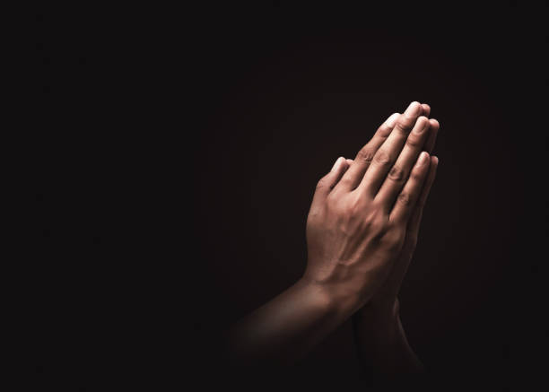
Prayer point
Please pray for smooth and peaceful conduct of legislative assembly election of Manipur which starts from 28th February to 5 March and for fare election.
Thank God for restoring peace in Manipur

Slide 28
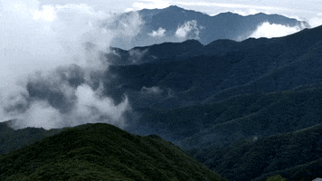
MEGHALAYA
Is a hilly state in northeastern India. The name means
“The Abode of Clouds”in Sanskrit.

Slide 29
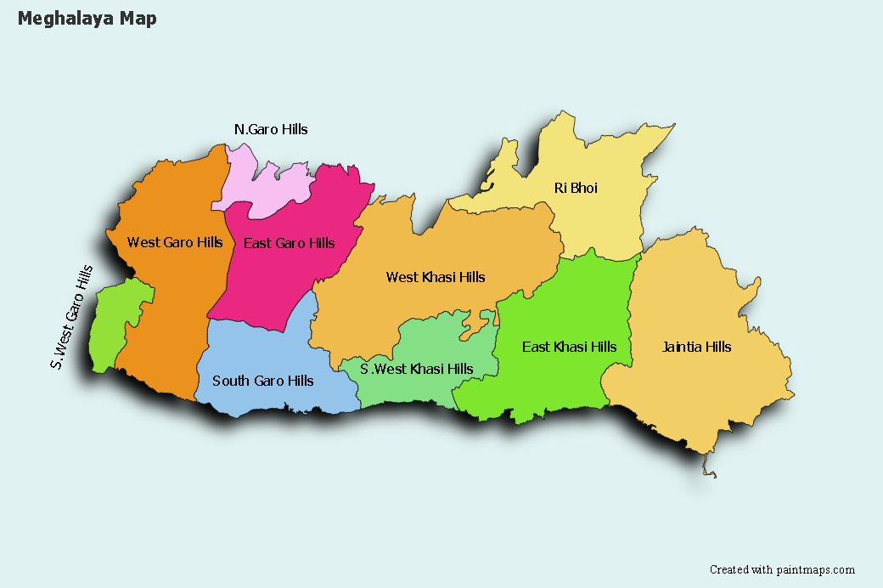
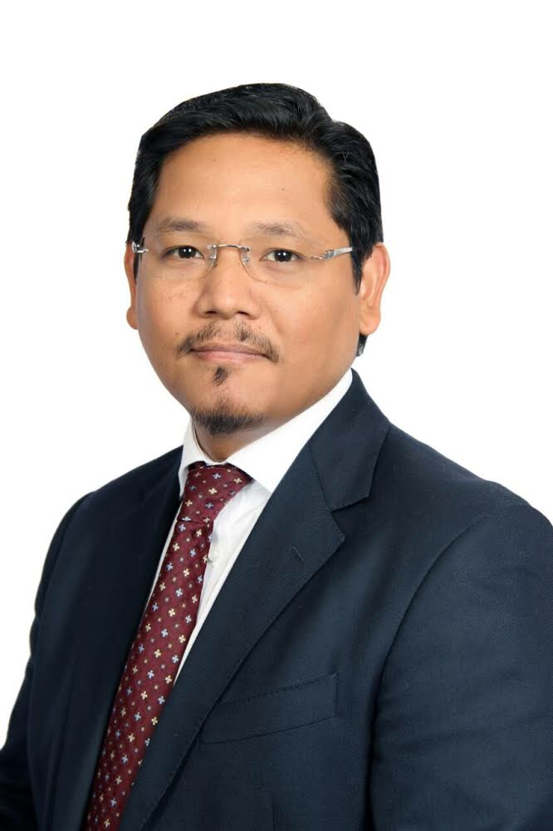
Capital : Shillong
CM: Mr. Conrad Sangma
God is within her, she will not fall;
God will help her at break of day. Psalms 46:5

Slide 30
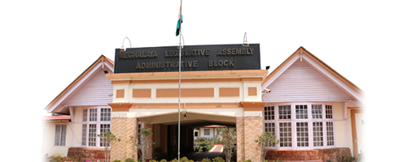
MEGHALAYA Shadow Parli
Speaker : Sol. Angkung
It has 60 Assembly Constituencies
Name of PC | Name of MP | Name of SMP | Inherited | DOI
1) Shillong
2) Tura

Slide 31
Praise God!!!
God loves His people
Despite there was a low-intensity blast in the heart of Shillong,
the capital of Meghalaya recently, still no casualties reported
Thank God that He protected the people from this blast!

Slide 32
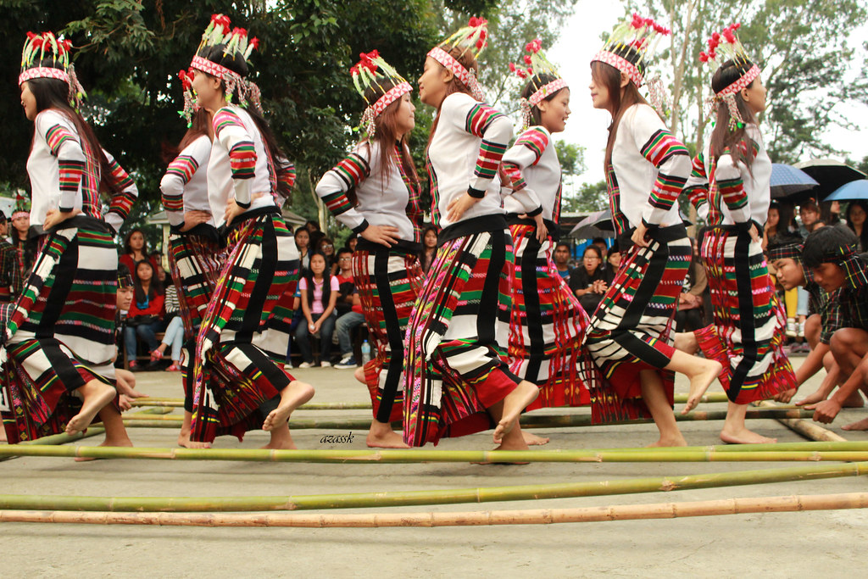
MIZORAM
Is a state in northeastern India, with Aizawl as its capital city. The name is derived from “Mizo” the name of the native in habitants, and “Ram”, which means land.

Slide 33
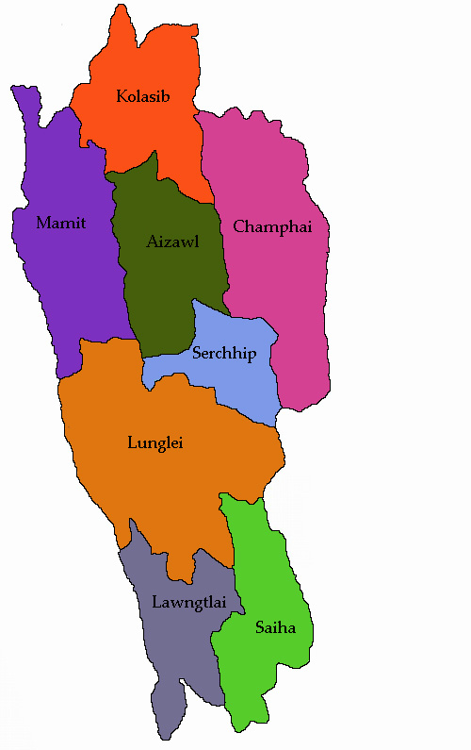
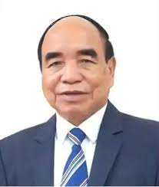
MIZORAM Shadow Parli
Speaker: Sol.
Mizoram
has got 40 Assembly Constituencies
CM : Mr. Zoramthanga

Slide 34
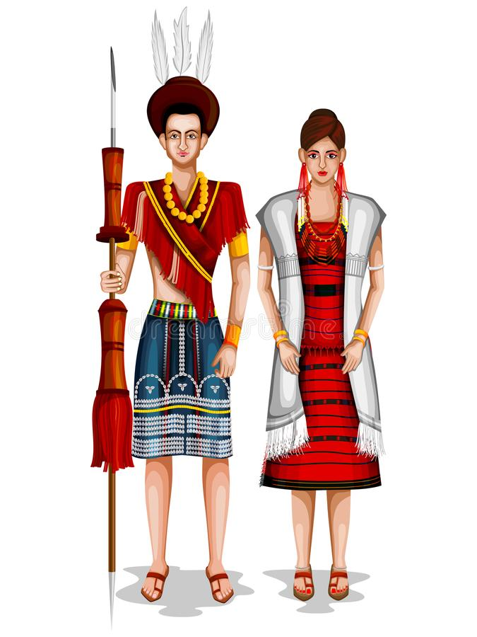
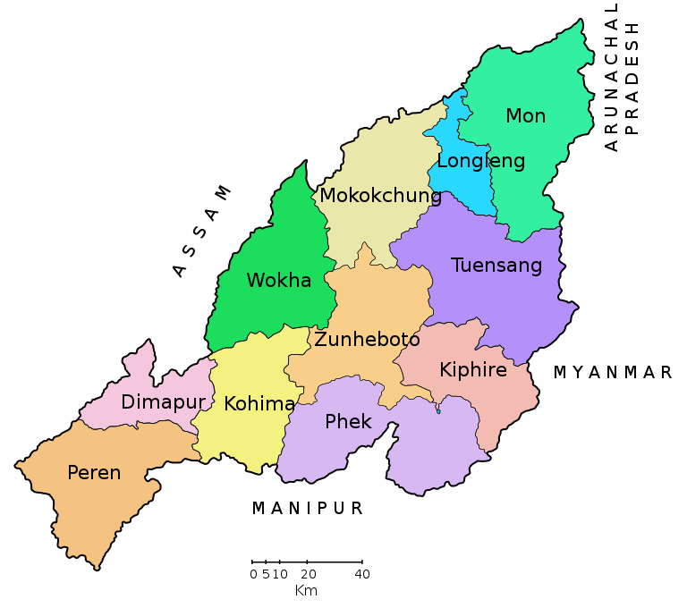
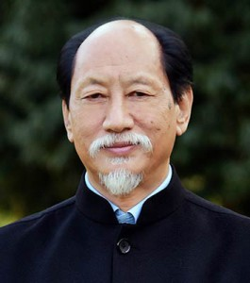
NAGALAND
is a mountainous state in northeast India, bordering Myanmar. It's home to diverse indigenous tribes
Its capital city of Kohima suffered heavy fighting in World War II
CM: Mr. Neiphiu Rio

Slide 35
Gift school conducted

Slide 36

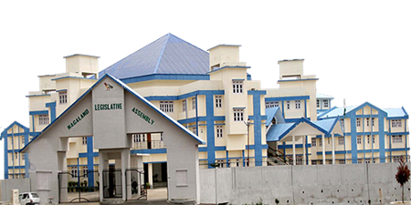
NAGALAND Shadow Parli
Speaker: Sol. Rev. Dr. Ayang Sor
Nagaland
has got 60 Assembly Constituencies
Name of PC | Name of MP | Name of SMP | Inherited | DOI
1) Nagaland | Mr. Tokheho Yepthomi | Sol. Rev. Dr. Ayang Sor | Yes | 7.2.2020

Slide 37
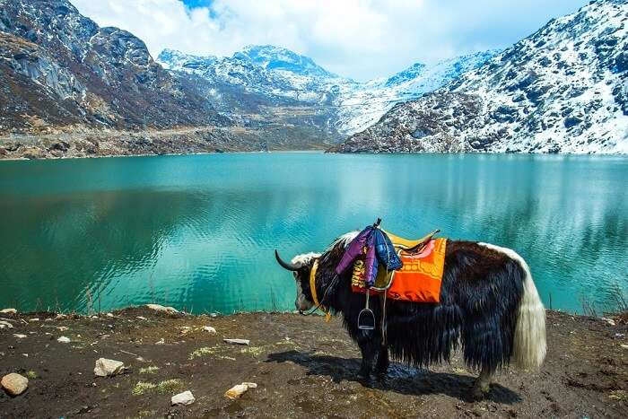
Sikkim
Sikkim is a state in northeast India, bordered by Bhutan, Tibet and Nepal. Part of the Himalayas, the area has a dramatic landscape that includes India’s highest mountain, 8,586m Kangchenjunga. home to glaciers, alpine meadows and thousands of varieties of wildflowers. Steep paths lead to hilltop Buddhist monasteries such as Pemayangtse, which dates to the early 1700s.

Slide 38
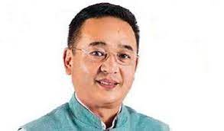
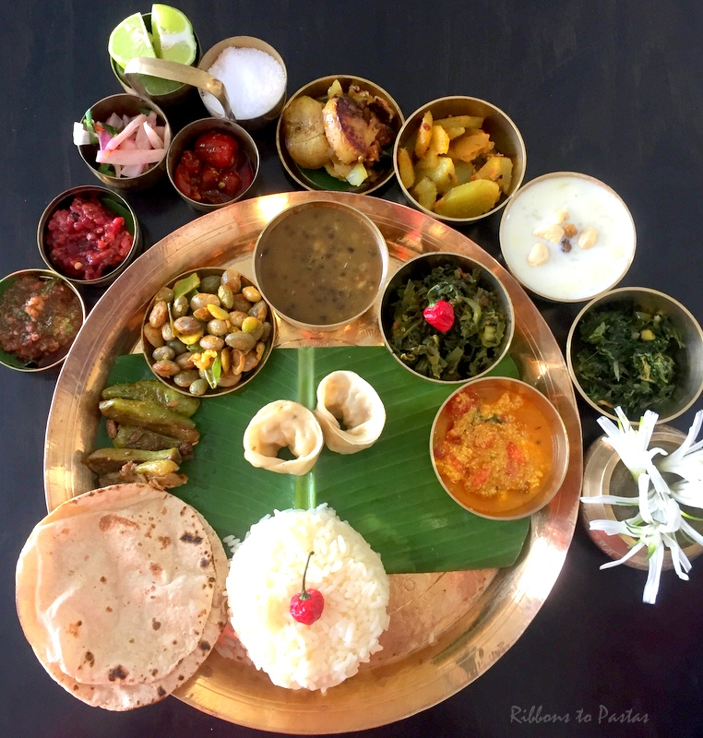
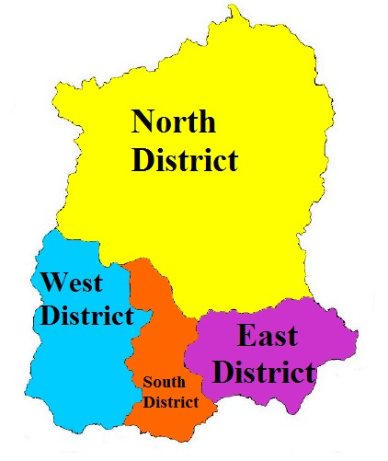
CM of Sikkim
Mr. Prem Singh Tamang

Slide 39
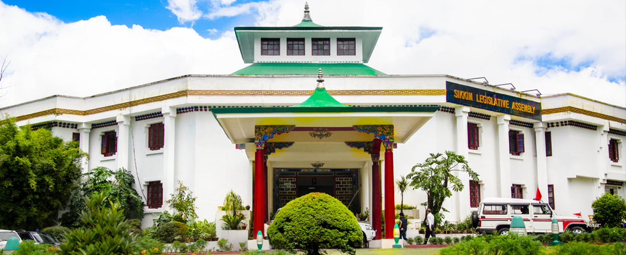
SIKKIM Shadow Parli | Speaker: Sol. Yania Uli
Capital of Gangtok
& got 32 Assembly Constituencies

Slide 40

Capital : Agartala, top in Smart City ranking in NE
Tripura is a hilly state in northeast India, bordered on 3 sides by Bangladesh, and home to a diverse mix of tribal cultures and religious groups. In the capital Agartala

Slide 41
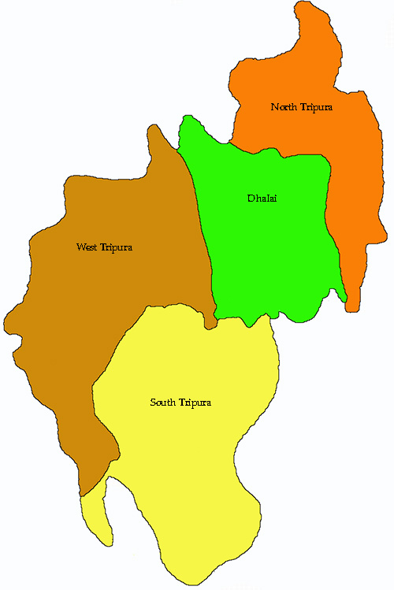
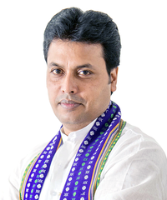
TRIPURA
Tripura
has got 60 Assembly Constituencies
CM of
Tripura: Mr. Biplab Kumar Deb
Psalms 46:11
The Lord Almighty is with us;
the God of Jacob is our fortress.

Slide 42
MONTHLY PRAISE REPORT (North-East Zone):
6th March, 2022- 31stMarch, 2022
No of BFF – Nil
No. of Worship School – 1
No. of Hospitality School – Nil
No. of Deliverance School- 2
No. of Healing School – 1
No. of Prophecy School – Nil
No. of Family Building – Nil
Contd…next slide

Slide 43
MONTHLY PRAISE REPORT (North-East Zone):
6th March, 2022- 31stMarch, 2022
8. No. of Financial Discipline – Nil
9. Daniel Academy Upgradation Prayer:
10. No. of night prayer :
11. Online Worship by NE team–
12. Everyday Worship – 4
13. Daily Morning Worship- 6am to 7:30am..Arunachal, Assam
14. Daily 15 min of Prayer Session (9-9.15pm) – Cont..
15. Daily Morning Worship: Continuing
16. Regional conference: Nil
17. Core committee meeting: Nil
18. Wheel Wing meeting:
19. CBS Up gradation Prayer: Continues

Slide 44
The NE India family “Thank God” for leading us thus far!!!

